Slide 1


Text Generation Natural Language processing
NLP
هديل الشهري

Slide 2
Definition
Produce plausible and readable text in human language from the input data in a variety of forms including text, image, tabular and knowledge base.
01

Slide 3
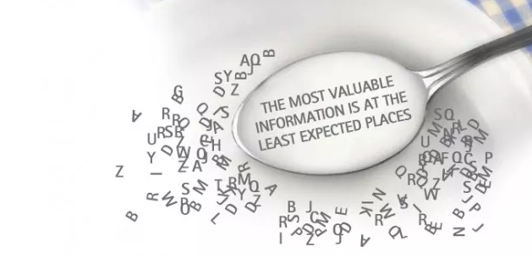
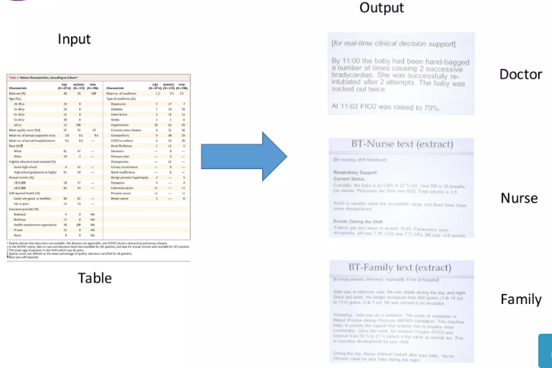

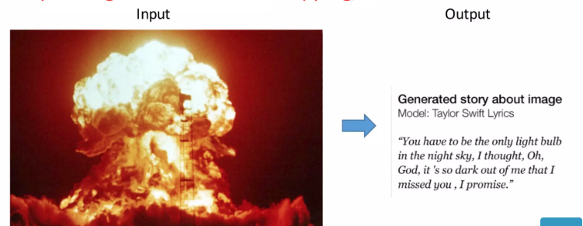
Type of Inputs
01.
02.
03.
04.
04.
Text To Text
Image to Text
Table to Text
نص الى نص
نص الى نص

Slide 4
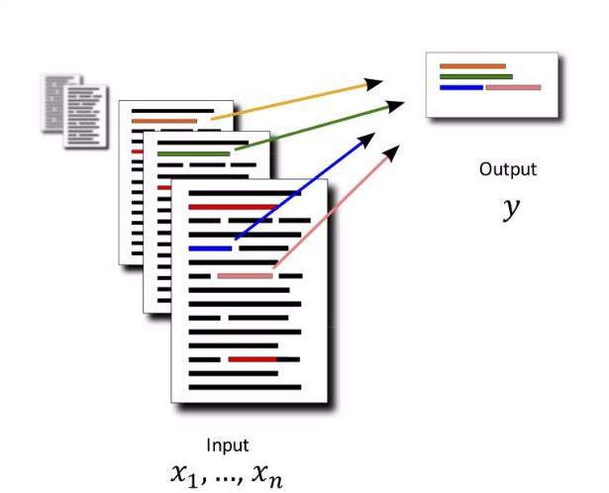
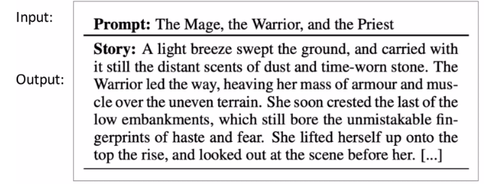

Used
04.
Storytelling
Summarization
04.
Translation
نص الى نص
نص الى نص

Slide 5

Technology
SeqtoSeq ) encoder – decoder Approach )
encoder map input sequence to a fixed- size vector
decoder maps the vector to the target sequence
It map Input Text to output Text under encoder – decoder Approach
The words will be convert to number depend on the sequence of the words
For Example
sentence “ I love to read science books”
I love to read science books
4 15 30 3 6
The word vector will be [X,Y]
X= I love to Y = read
X= love to read Y = science
SeqtoSeq
The vector will be consist of X,Y depend on “ length number N”
Let N = 3
2014
Deep learning
After the speed of CPUs had increased significantly
This is the Feature the Model will used

Slide 6
Technology
؟
It map Input Text to output Text under encoder – decoder Approach
It used RNN Models
Transformers Model
SeqtoSeq
؟
2014
Deep learning
2017
Attention
Approach
That depend on
1- encoder
2- Attention
3- self Attention
After the speed of CPUs had increased significantly

Slide 7
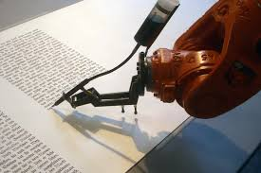
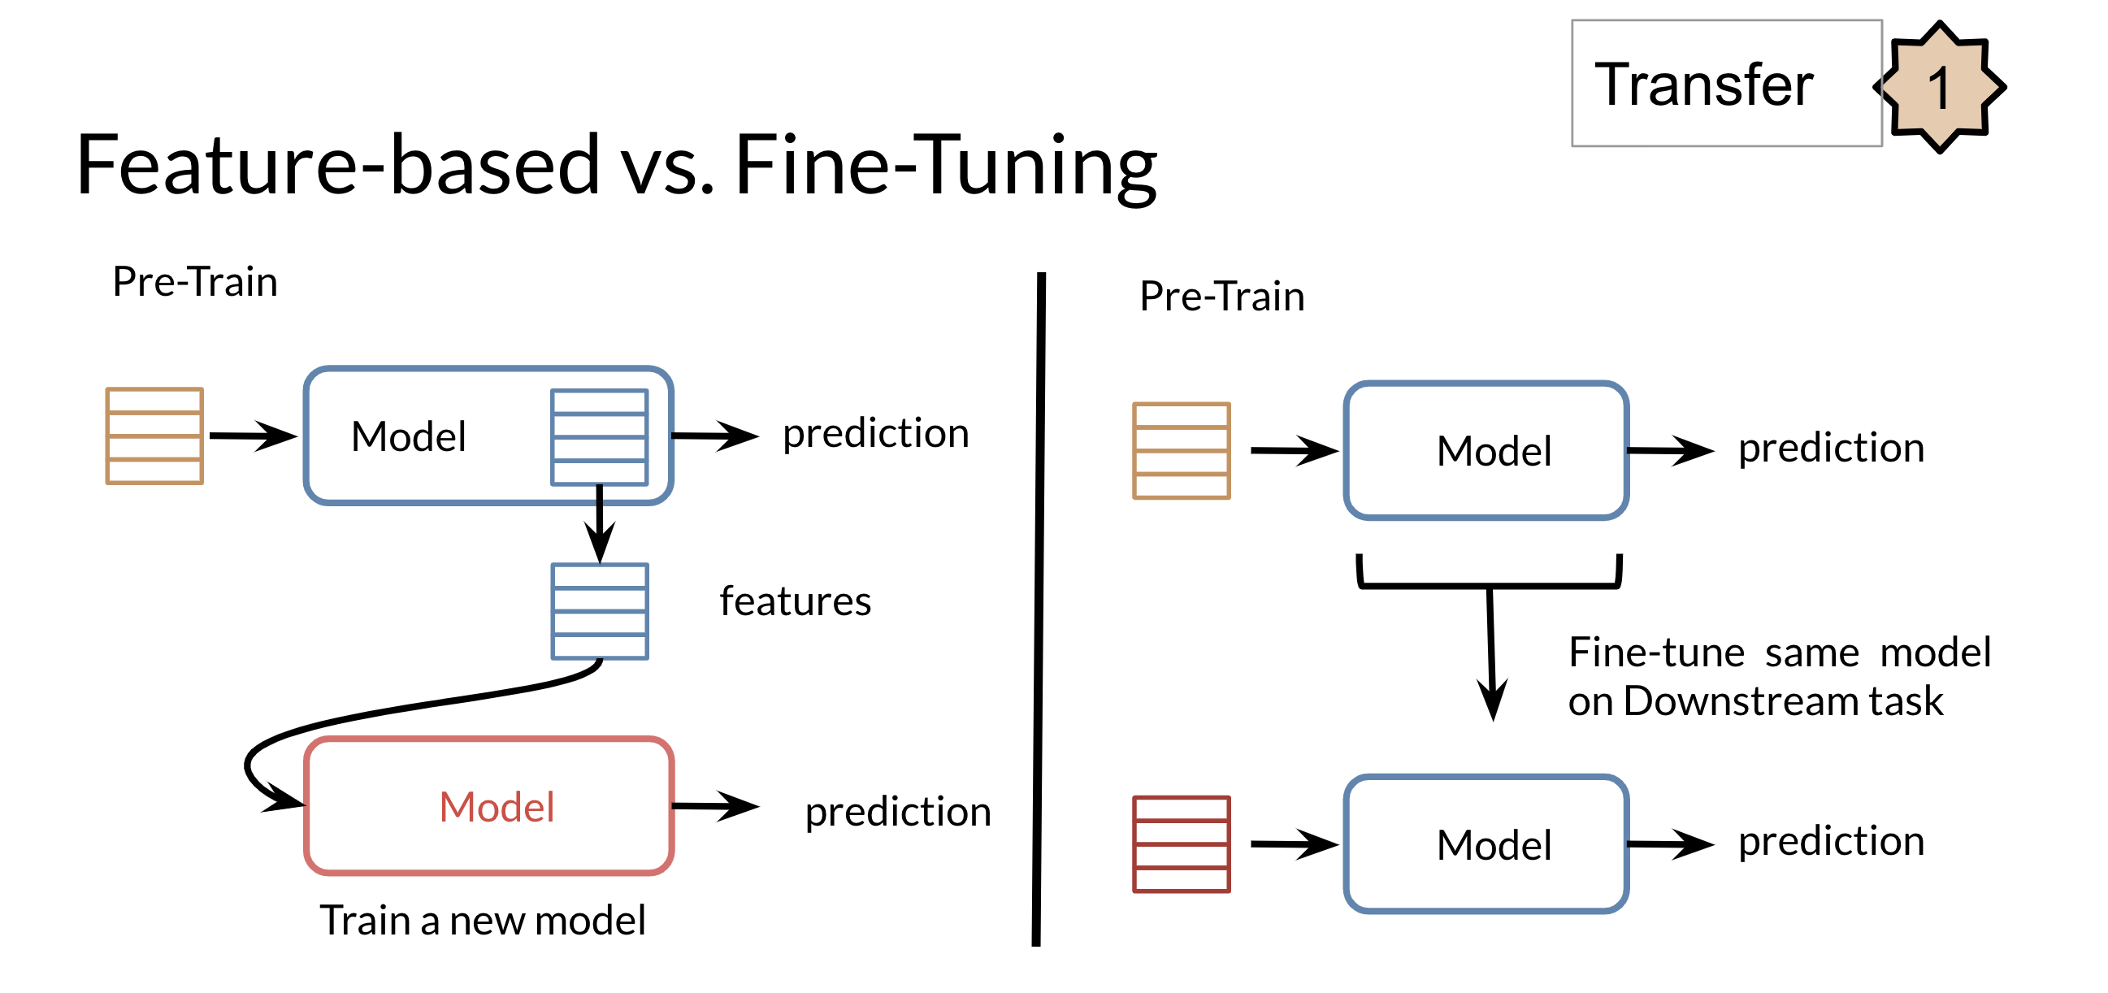
Is Deep learning have been used for writing or generating any type of Text?
The classical type of DL need a manually labeled data set to train the model on it
On some domain there is not enough labeled data set

Slide 8
Fine Tuning
Fine-tuning deep learning involves using weights of a previous deep learning algorithm for programming another similar deep learning process.

Slide 9
Technology
That uses
Fine Tuning
PLMs
It map Input Text to output Text under encoder – decoder Approach
It used RNN Models
Transformers Model
SeqtoSeq
2014
Deep learning
2017
Attention
Approach
That depend on
1- encoder
2- Attention
3- self Attention
After the speed of CPUs had increased significantly
knowledge-based

Slide 10
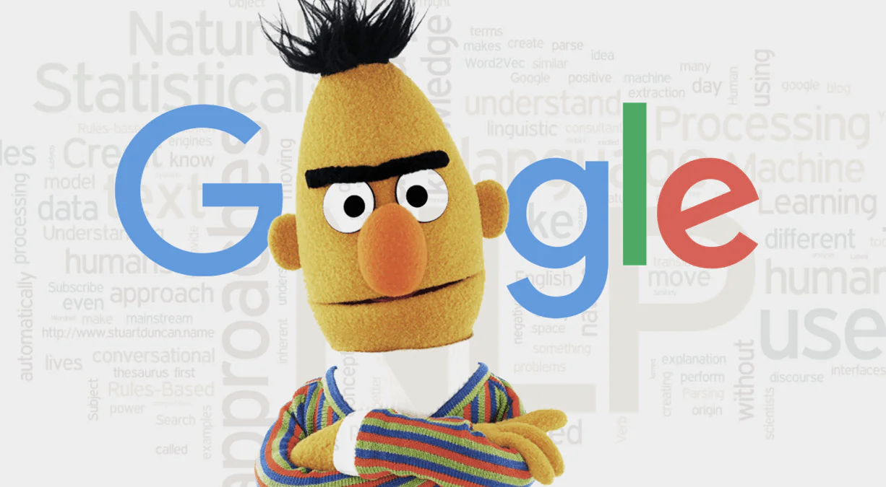
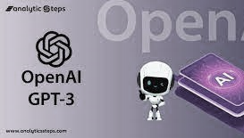
What is PLMs ?
Pre Trained Language model that fisrt pretrain the model on large scale unsupervised corpus and then fine tune these model in downstram supervise tasks.
The most example of PLMs
BERT and OpenAI GPT

Slide 11
What is Bert?
BERT is an open source machine learning framework for natural language processing (NLP). BERT is designed Google. The BERT framework was pre-trained using text from Wikipedia and can be fine-tuned with question and answer datasets.
BERT, which stands for Bidirectional Encoder Representations from Transformers, is based on Transformers,

Slide 12
What is GPT?
GPT is a Transformer-based architecture and training procedure for natural language processing tasks. Training follows a two-stage procedure. First, a language modeling objective is used on the unlabeled data to learn the initial parameters of a neural network model. These parameters are adapted to a target task using the corresponding supervised objective.

Slide 13
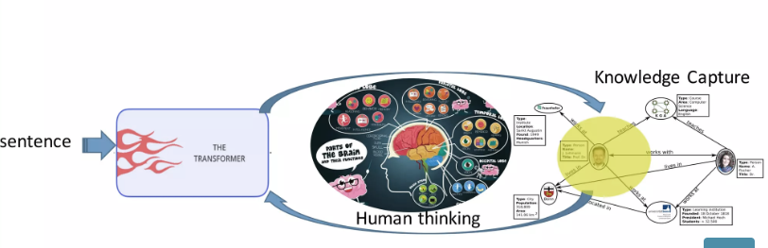
What is knowledge-based?
The input text alone contains limited knowledge to support general model to produce desired output.
knowledge-based is mimic the human brain. Humman are acqurining, understanding, and storing knowledge.

Slide 14
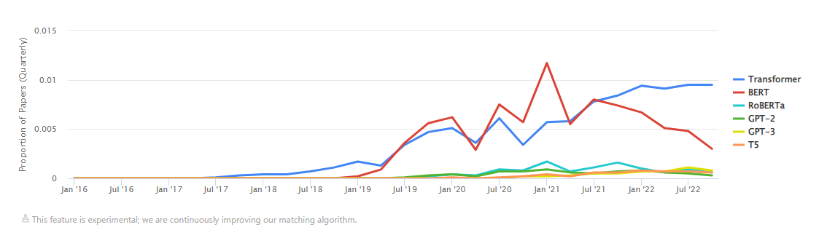
Technology Used Overtime
Based on Codeshttps://paperswithcode.com/

Slide 15
Evaluation
04.
04.
01.
02.
Automatic Evaluation
Human Evaluation
نص الى نص
نص الى نص
Using Human to decide the text generated Text has generate by machine or human
Using Automatic Metrics without human decision

Slide 16
Automatic Evaluation
04.
04.
01.
02.
03.
Semantic Similarity Metrics
N-Gram Overlap Metrics.
نص الى نص
Diversity Metrics.
نص الى نص
These metrics measure the degree of “ matching “ between machine generated and ground- truth texts,
Lexical diversity is desirable in many text generation tasks.
By utilize the neural network to capture meaning and synt
BLEU، ROUGE، METEOR، ChrF++
Distinct
BERTScore

Slide 17

References
Junyi li, Tiany Tang, Wayne Xin Zhao , Jian-Yun Nie, Ji-Rong Wen (2022) “A Survey of Pre-trained Language Models Based Text Generation”
Wenhao Yu, Chengang, Zaitang Li, Zaitang Hu, Henq Ji, Meng Jiang (2020) “ A Survey of Knowledge- Enhanced Text Generation “

Slide 18
Thank you

